Slide 1
Spend Analysis Project
Team 2
Fall 2023

Slide 2
Overview
Total Spend, Commodity Categories, & Market Baskets
Industry Analysis and Supply Segmentation
Supplier & Buyer Analysis
Sourcing Strategy / Estimates
Spend Analysis Process & Challenges

Slide 3
Labor in Federal contracts
The labor rate in federal construction contracts is established by the Davis-Bacon Act.
This act mandates that contractors and sub-contractors be paid the prevailing wage.
The Department of Labor is tasked with determining the prevailing wage for each specific project based on location, type of construction, and current wage determination.
Market research indicates that between 20-40% of the value of federal construction contracts are attributable to labor.
For the subsequent spend analysis we have removed 30% of the dollar value from all construction related contracts to account for the included labor rate. All values in the remaining presentation should be assumed to be material costs only.

Slide 4
Commodity Category
Construction
Market Basket
236210 – Industrial Building Construction
236220 – Commercial and Institutional Building Construction
83 Ordering Locations
1,863 Current Contracts
248 Current Suppliers

Slide 5
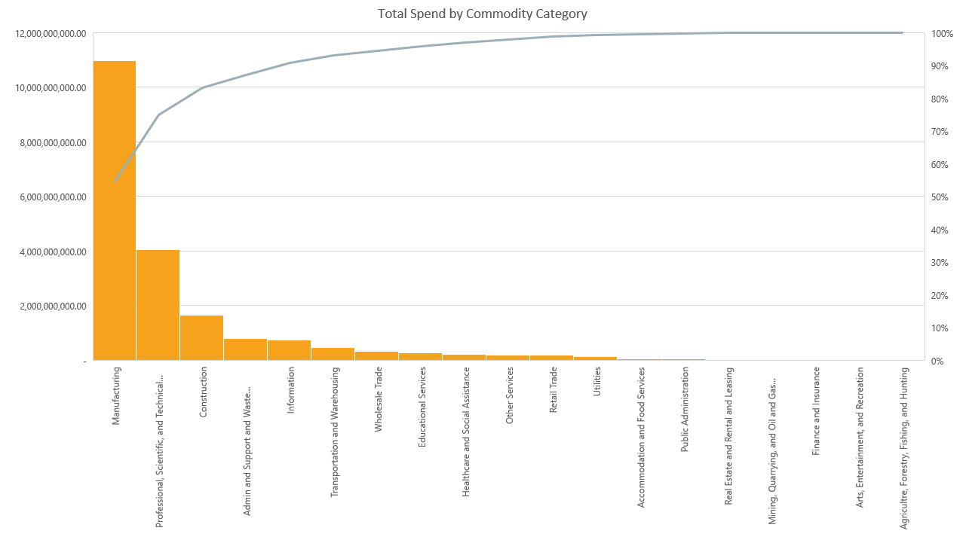

Slide 6
Spend Within Market Basket

Slide 7
Top 30 Contract Office Locations
Office Code | Base Name | Contract Spend | Number of Contracts | Percentage of Total Spend | Percentage of Contract Actions
FA8903 | JBSA LACKLAND | $ 425,545,787.49 | 62 | 45.38% | 3.46%
FA3002 | RANDOLPH AFB | $ 189,447,633.12 | 66 | 20.20% | 3.68%
FA7000 | USAF ACADEMY | $ 38,079,390.24 | 36 | 4.06% | 2.01%
FA4608 | BARKSDALE AFB | $ 16,080,472.21 | 77 | 1.71% | 4.29%
FA8201 | HILL AFB | $ 15,369,852.18 | 105 | 1.64% | 5.85%
FA4801 | HOLLOMAN AFB | $ 15,245,189.58 | 49 | 1.63% | 2.73%
FA5209 | APO | $ 13,700,927.21 | 75 | 1.46% | 4.18%
FA2517 | PETERSON AFB | $ 13,483,283.18 | 90 | 1.44% | 5.02%
FA4407 | SCOTT AFB | $ 12,511,430.18 | 28 | 1.33% | 1.56%
FA4814 | TAMPA | $ 10,666,260.07 | 63 | 1.14% | 3.51%
FA3020 | SHEPPARD AFB | $ 7,821,247.62 | 35 | 0.83% | 1.95%
FA6656 | VIENNA | $ 7,730,499.00 | 20 | 0.82% | 1.11%
FA5205 | APO | $ 7,684,978.32 | 34 | 0.82% | 1.90%
FA8501 | ROBINS AFB | $ 7,387,241.45 | 91 | 0.79% | 5.07%
FA4803 | SHAW AFB | $ 7,231,764.89 | 21 | 0.77% | 1.17%

Slide 8
Top 30 Contract Office Locations (cont.)
Office Code | Base Name | Contract Spend | Number of Contracts | Percentage of Total Spend | Percentage of Contract Actions
FA4460 | LITTLE ROCK AFB | $ 7,059,020.75 | 6 | 0.75% | 0.33%
FA4659 | GRAND FORKS AFB | $ 6,401,415.10 | 18 | 0.68% | 1.00%
FA4620 | FAIRCHILD AFB | $ 6,180,095.75 | 30 | 0.66% | 1.67%
FA6606 | WESTOVER AFB | $ 6,033,870.42 | 13 | 0.64% | 0.72%
FA4877 | DAVIS MONTHAN AFB | $ 5,281,385.13 | 52 | 0.56% | 2.90%
FA4484 | JOINT BASE MDL | $ 5,274,346.04 | 97 | 0.56% | 5.41%
FA2543 | BUCKLEY AFB | $ 5,191,162.26 | 50 | 0.55% | 2.79%
FA4497 | DOVER AFB | $ 4,905,549.39 | 5 | 0.52% | 0.28%
FA4626 | MALMSTROM AFB | $ 4,828,100.31 | 24 | 0.51% | 1.34%
FA9301 | EDWARDS AFB | $ 4,796,161.30 | 53 | 0.51% | 2.95%
FA6712 | CORAOPOLIS | $ 4,756,240.74 | 12 | 0.51% | 0.67%
FA4613 | FE WARREN AFB | $ 4,568,769.35 | 30 | 0.49% | 1.67%
FA5215 | JBPHH | $ 4,512,527.52 | 8 | 0.48% | 0.45%
FA4809 | SEYMOUR JOHNSON AFB | $ 4,405,682.07 | 25 | 0.47% | 1.39%
FA4819 | TYNDALL AFB | $ 4,395,412.43 | 47 | 0.47% | 2.62%

Slide 9
Supplier Density in Market Basket
Commercial & Institutional Construction
Industrial Construction

Slide 10
Primary cost drivers
Labor
As stated, labor can make up 20-40% of the cost of a contract
Labor shortages can drive the percentage higher
The construction company needs to rely on overtime or advertise an increased wage to bring in new workers (2022 U.S. Construction Cost Trends)
Materials
The scale of the project will determine the costs of the materials and equipment used
If equipment malfunctions and breaks down, this can cause a delay in the project deadline
If more time is needed to complete the project, that will directly increase labor costs.
Supply chain disruptions can cause higher costs for materials
Expensive substitute materials can be brought in if other materials are not available
Energy, steel, lumber and concrete are some of the costly materials needed for a project (2022 U.S. Construction Cost Trends)
Margins
Margin costs are dependent on the market demand. (2022 U.S. Construction Cost Trends)

Slide 11
Pricing for federal contracts
The estimated price for federal construction projects falls under the following ranges (Disclosure of the Magnitude of Construction Projects) :
Less than $25,000
Between $25,000 and $100,000
Between $100,000 and $250,000
Between $250,000 and $500,000
Between $500,000 and $1,000,000
Between $1,000,000 and $5,000,000
Between $5,000,000 and $10,000,000
More than $10,000,000

Slide 12
Construction technology
The construction industry is leaning into technology for sourcing, management and materials
According to Accenture, they believe AI can increase industry profits by 71% by 2035 (Ellis, 2023)
Implementing AI has the potential to improve data, transparency and communication
3D printing is utilized for various parts and fixtures (Ellis, 2023)
Using the technology can cut cost with labor and can bridge the gap with supply chain delays
Digital twins optimize the performance and productivity within the construction workflow by creating a virtual copy of a building (Ellis, 2023)
The use of a digital twin bridges the gap between form and function
Resource and Workforce Management Software
Sensor Data provides visibility to the construction workflow. (Ellis, 2023)
Sensor data can be used to forecast, track materials, monitor site conditions all while continuously improving worker safety
Autodesk Takeoff and BuildingConncted are software's that are useful for creating and centralizing competitive bids from accurate estimates (Ellis, 2023)

Slide 13
Competition in the industry
Bidding is a significant aspect within federal contracts
Suppliers for low to mid-range projects are procured through “sealed bidding, low-price technically acceptable competitive proposals, or competitive orders against existing multiple-award IDIQ construction contracts.” (Bidding on Federal Construction Projects, 2023)
Suppliers for major construction projects are sourced using the Federal Acquisition Regulation (FAR) source selection
Bidding for government contracts became the standard in 1985 after CICA (Competition in Contracting Act) was established in 1984 (Wenton, Brown & Schmitt, 2023)
The process includes sealed bidding and allows businesses of all sizes to take part in the competition for a government contract
The overall goal is to encourage competition that will translate into savings for the buyer

Slide 14
Types of contracts
Lump-Sum Contract (Fixed Price Contract) – A fixed price is established for the labor and materials needed to accomplish a project (Types of Contracts, 2023)
This style of contract would work well for 236210 and 236220 if the needs for the project are defined in time
Cost-Plus Contract – Contractors are reimbursed for the costs involved to accomplish a project. The costs include labor, equipment and materials paired with a fixed fee or markup rate (O’Donnell & Gray, 2023)
Time and Materials (T&M) Contract – Contractors are reimbursed for the material costs. Labor is costed out on a fixed or hourly rate. T&M contracts pose a high risk of unknown or increased costs passed down to the buyer if this is not specified in the contract (O’Donnell & Gray, 2023)
Unit Pricing Contract
These contracts work best for the 236210 and 236220 because of the repeated jobs within the baskets. Unit price contracts can provide simplified pricing for repeated jobs
Design-Build Contract – During the bidding process, the project owner will receive completed designs. Design and construction are completed simultaneously under one contract. (O’Donnell & Gray, 2023)
Guaranteed Maximum Price (GMP) Contract – Maximum price is agreed upon within the contract. If costs exceed the agreed price, the contractor will cover the additional costs. (O’Donnell & Gray, 2023)

Slide 15
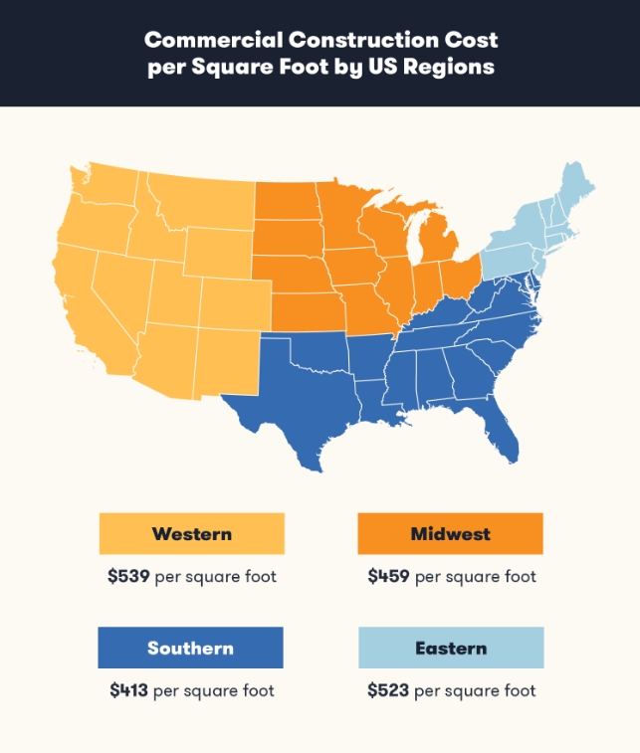
Estimated regional rates
The southern region has the cheapest commercial construction costs at $413 per square foot. The western region has the highest rates with $539 per square foot (Commercial Construction Cost per Square Foot in the US, 2023)
Out of the top thirty contract office locations, 33% of the locations are in the southern region

Slide 16
236210 - Duration of contracts
Contracts under 236210 - Commercial and Institutional Building Construction range from 13 days to 611 days
The average duration of a contract is 223.1 days
Jobs ranged from repairing an HVAC system to replacing windows.

Slide 17
236220 - Duration of contracts
Contracts under 236210 - Commercial and Institutional Building Construction range from 13 days to 611 days
The average duration of a contract is 223.1 days
Jobs ranged from an alarm system upgrades to repairing a missile warning center

Slide 18
Duration of contracts (cont.)
Because of the wide range of tasks completed under the market baskets, the duration of the contracts will vary based on the complexity and scale of the job.
For jobs such as painting, replacing carpets or simple installs need to be completed within one to six months
Extensive installs will range from six months to two years
Large scale builds and renovation contracts will have a duration range of one to three years.

Slide 19
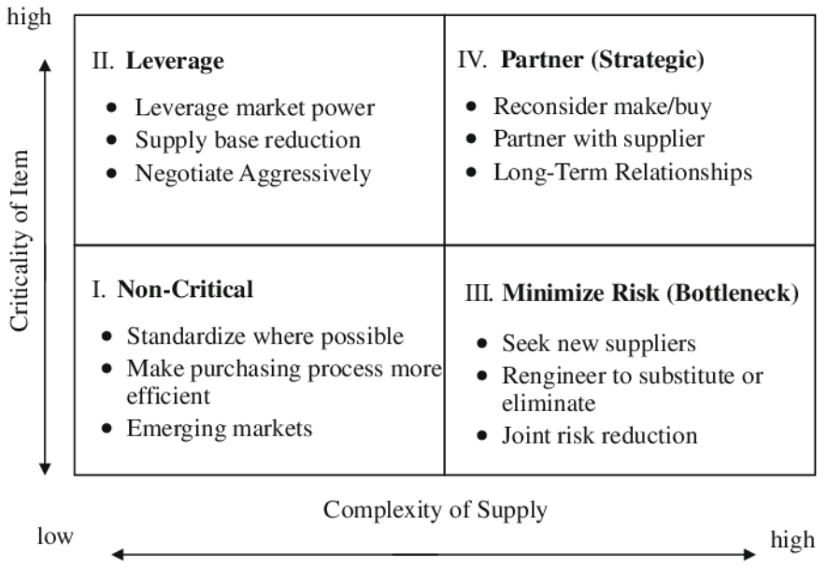
236210 - Industrial Building Construction
47 Suppliers
126 Contracts, 22 Buying Locations

Slide 20
236210 - Industrial Building Construction
4 Duplicate Suppliers
NAICS Code | Vendor Name | City | State | DUNS Number
236210 | CCI GROUP, LLC | SHALIMAR | FL | 829452221
236210 | CHUGACH GOVERNMENT SERVICES, INC | ANCHORAGE | AK | 556637366
236210 | CHUGACH INDUSTRIES INC | ANCHORAGE | AK | 142120745
236210 | EDILNOVA DI BOGLIONE GEOM. ALBERTO & C SNC | PORDENONE |  | 430021931
236210 | EDILNOVA DI BOGLIONE GEOM. ALBERTO & C SNC | PORDENONE | PORDENONE | 430021931
236210 | NIPPO CORPORATION | CHUO-KU |  | 690567938

Slide 21
236210 - Industrial Building Construction
Estimated $ value for 5 years
 |  | Rate Of change | Inflation
236210 | 84892964.01
2009 | 5512692.55
2010 | 79380271.46 | 0.93 | 1.93
Future values
2011 | 153203923.9
2012 | 295683573.2
2013 | 570669296.2
2014 | 1101391742
2015 | 2125686061

Slide 22
236210 - Industrial Building Construction

Slide 23
236220 - Commercial and Institutional Building Construction
203 Suppliers
1,737 Contracts, 77 Buying Locations

Slide 24
Duplicates in 236220
236220 | AMEC EARTH & ENVIRONMENTAL INC | PLYMOUTH MEETI | PA | 38086125
236220 | AMEC EARTH & ENVIRONMENTAL, INC. | PLYMOUTH MEETING | PA | 38086125
236220 | AMSTAR INC | SAN ANTONIO | TX | 847833712
236220 | AMSTAR, INC. | SAN ANTONIO | TX | 847833712
236220 | B&M CONSTRUCTION, INC. | COLORADO SPRINGS | CO | 135020316
236220 | B&M PHIPPS | COLORADO SPRINGS | CO | 961653644
236220 | BARLOVENTO LIMITED LIABILITY COMPANY | DOTHAN | AL | 7742190
236220 | BARLOVENTO, L.L.C. | DOTHAN | AL | 7742190
236220 | CCI GROUP, LLC | SHALIMAR | FL | 829452221
236220 | CCI SOLUTIONS OF ALASKA LLC | SHALIMAR | FL | 963613372
236220 | CHUGACH GOVERNMENT SERVICES INCORPORATED | ANCHORAGE | AK | 556637366
236220 | CHUGACH GOVERNMENT SERVICES, INC | ANCHORAGE | AK | 556637366
236220 | COTHRAN TRUCKING, LLC | WICHITA FALLS | TX | 620356191
236220 | COTHRAN TRUCKING,LLC | WICHITA FALLS | TX | 620356191
236220 | COTHRAN TRUCKINGLLC | WICHITA FALLS | TX | 620356191
236220 | DIVERSIFIED MAINTENANCE SYSTEM | SALT LAKE CITY | UT | 36683282
236220 | DIVERSIFIED MAINTENANCE SYSTEMS INCORPORATED (7589) | SALT LAKE CITY | UT | 122503589
236220 | DIVERSIFIED MAINTENANCE SYSTEMS, INC. | SALT LAKE CITY | UT | 122503589
236220 | DIVERSIFIED MAINTENANCE SYSTEMS, INC. | TUCSON | AZ | 962312968
236220 | DWG & ASSOCIATES, INC | COLORADO SPRIN | CO | 956520274
236220 | DWG & ASSOCIATES, INC | COLORADO SPRINGS | CO | 956520274
236220 | DWG & ASSOCIATES, INC. | COLORADO SPRINGS | CO | 956520274
236220 | DWG AND ASSOCIATES INCORPORATED | COLORADO SPRINGS | CO | 956520274
236220 | HARMON COMMERCIAL AND INDUSTRIAL CONSTRUCTION INCORPORATED | MACON | GA | 123776697
236220 | HARMON COMMERCIAL AND INDUSTRIAL CONSTRUCTION, INC | MACON | GA | 123776697
236220 | INNOVATIVE TECHNICAL SOLUTIONS | WALNUT CREEK | CA | 874569015
236220 | INNOVATIVE TECHNICAL SOLUTIONS, INC. | WALNUT CREEK | CA | 874569015
236220 | JACOBS GOVERNMENT SERVICES COM | PASADENA | CA | 602889508
236220 | JACOBS GOVERNMENT SERVICES COMPANY | PASADENA | CA | 602889508
236220 | JSR ECC LLC | SCHERTZ | TX | 962368960
236220 | JSR, INC | SCHERTZ | TX | 133308283
236220 | JSR, INC. | SCHERTZ | TX | 133308283
236220 | MA-CHIS LOWER CREEK INDIAN TRIBE ENTERPRISES INC | SAMSON | AL | 360613710
236220 | MA-CHIS LOWER CREEK INDIAN TRIBE ENTERPRISES, INC | KINSTON | AL | 360613710
236220 | MARVIN GROVES ELECTRIC CO., INC. | WICHITA FALLS | TX | 68378645
236220 | MARVIN GROVES ELECTRIC COMPANY INCORPORATED | WICHITA FALLS | TX | 68378645
236220 | MIC/CCS JOINT VENTURE | PARKER | CO | 76900393
236220 | MIC/CCS JOINT VENTURE | SOUTH JORDAN | UT | 76900393
236220 | NIPPO CORPORATION | AOMORI |  | 691633861
236220 | NIPPO CORPORATION | CHUO-KU |  | 690567938
236220 | TANAKA GUMI CO.,LTD. | MISAWA |  | 691208037
236220 | TANAKA GUMI TANAKA CONSTRUCTION KAMIKITA KENSETSU JV | MISAWA | AO | 697075059
236220 | TOLTEST, INC | MAUMEE | OH | 47306055
236220 | TOLTEST, INC. | MAUMEE | OH | 47306055
20 Duplicate Vendors

Slide 25
236220 - Commercial and Institutional Building Construction
Estimated $ value for 5 years
 |  | Rate Of change | Inflation
236220 | 1358822103
2009 | 60736391.53
2010 | 1298085712 | 0.9532108 | 1.9532108
Future Values
2011 | 2535435032
2012 | 4952239088
2013 | 9672766872
2014 | 18892952724
2015 | 36901919311

Slide 26
236220 - Commercial and Institutional Building Construction

Slide 27
Sourcing strategies
Competitive Bidding Within Framework Agreements
Why would this strategy be effective?
Competitive bidding encourages qualified suppliers to offer competitive prices within the framework’s qualifications
Bids can act as a benchmark for further cost analysis. The organization can compare the bids to other competitors, industry standards and historical benchmarks to confirm they rare receiving competitive rates
Pricing will be market driven meaning that suppliers must adjust their bid based on competition and market conditions. This prevents pricing from becoming unnecessarily stagnant or inflated
The selection process is efficient and relatively quick, making it ideal for sourcing suppliers under the construction market basket. Time delays can drive up the costs of a construction project due to prolonging the completion.

Slide 28
Sourcing strategies
Framework Agreements
Why would this strategy be effective?
The procurement process is streamlined as the framework agreement eliminates frequent bidding for each project
Reducing repeated bidding saves time, resources and lowers administrative burden
The agreements are beneficial for repetitive services, materials and goods
Discounts and pricing can be negotiated. Savings can also be achieved through bulk purchasing by aggregating the needs across multiple projects
Between both market baskets, there are repetitive projects such as repairing light fixtures, replacing windows and remodeling the inside of buildings.
Ex. The spend for repairing light fixtures across all projects can be aggregated leading to an advantage with economies of scale. This, along with negotiating bulk discounts with suppliers can lead to cost savings.

Slide 29
Sourcing strategies
Utilizing Local Sourcing
Why would this strategy be effective?
Local sourcing reduces transportation costs leading to savings in fuel and shipping costs
Global supply chains are highly susceptible to challenges such as geopolitical uncertainties, disruptions and delays
While delays and disruptions can still occur with this strategy, interruptions are reduced working with local suppliers
Local sourcing can lead to a simplified procurement process as local suppliers possess the knowledge regarding requirements and standards within a construction project
Local sourcing can be extremely beneficial with international projects as regulations will differ from domestic policies. Understanding the regulations upfront can save time and cost.

Slide 30
Sourcing strategies
Indefinite Delivery, Indefinite Quantity (IDIQ) Contracts
Why would this strategy be effective?
Specific project requirements may not be clear in advance but there is a need for a supplier. IDIQ contracts provide flexibility when situations like this occur
IDIQ contracts provide benefits such as volume discounts, flexibility within the contract, adaptability and compliance with federal contracting requirements
Additional benefits include pre-negotiated labor rates and prices providing additional cost savings
The organization will also save money with recurring projects and will know the costs upfront due to the pricing structure within an IDIQ contract

Slide 31
Sourcing strategies
Supplier Relationship Management (SRM) and Supplier Performance Metrics
Why would this strategy be effective?
An SRM can mitigate risks, optimize cost and address the distinctive challenges that can occur within a construction project
SRMs include visibility and traceability between the supplier and buyer. The parties can collaborate to solve challenges proactively
Risk management strategies within the SRM can lead to cost avoidance
Purchasing volume can be leveraged and used to negotiate volume discounts which can lead to lower unit costs
Supplier performance can be monitored against KPIs. Based on regular assessments, the organization can work with the supplier to improve their efficiency and enhance performance. Higher efficiency and better performance can equate to cost savings

Slide 32
Estimated dollar value for Commodity category
Years | Sum of Contract Values | Rate Of Change | Inflation
2009 | 250119968.4
2010 | 2043414961
Grand Total | 2293534929 | 0.87759707 | 1.87759707
Future Values
2011 | 3836709953
2012 | 7203795385
2013 | 13525825142
2014 | 25396049723
2015 | 47683548673

Slide 33
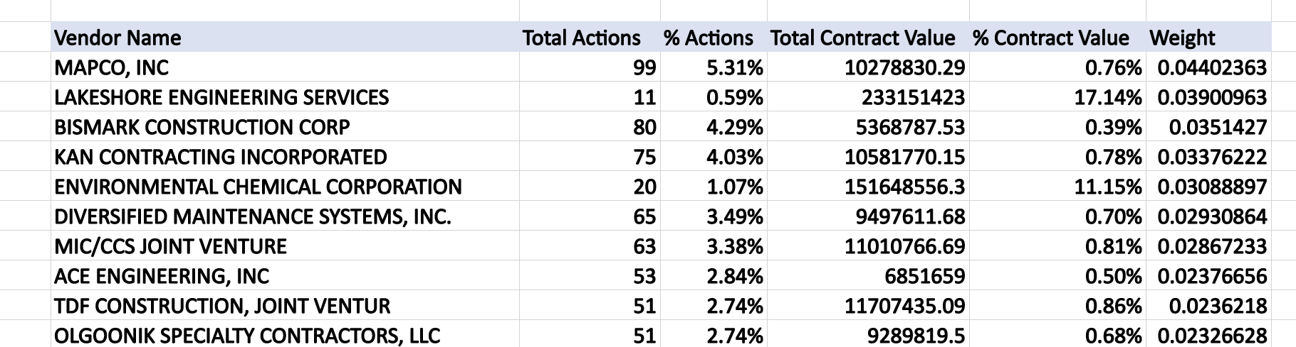
Proposed Number of Suppliers
Selecting suppliers depend on their number of contracts and the associated contract value for each.
Giving weightage of 80% to the number of contracts and 20% to the contract values, total of 59 suppliers are proposed with a shared weight cutoff of 0.004%
Below are the top 10 out of 59 selected suppliers.

Slide 34
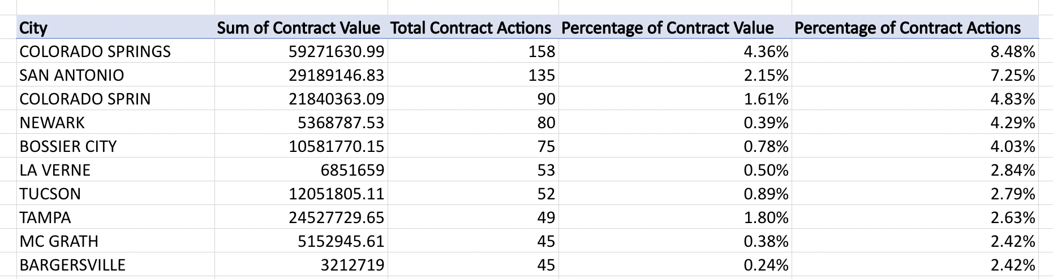
Proposed number of locations
A total of 39 buying locations are proposed with a contract actions percentage cutoff of 0.55 %
The top 10 out of 39 locations are :

Slide 35
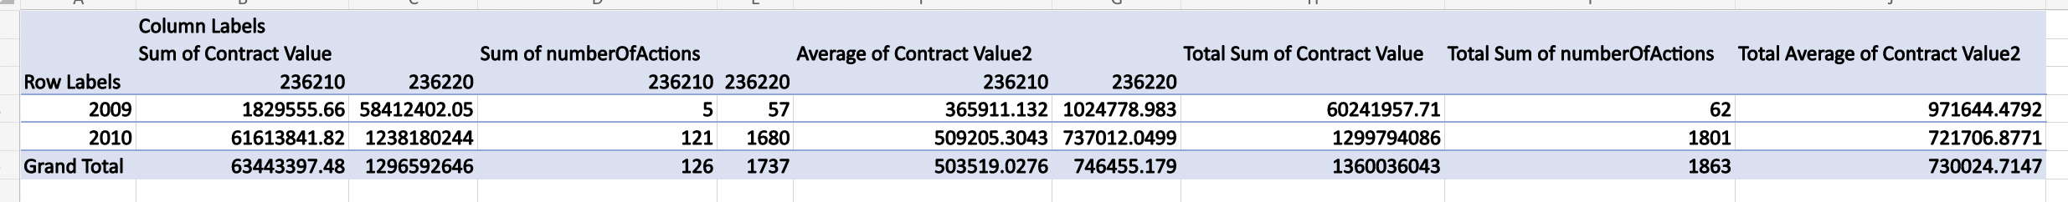
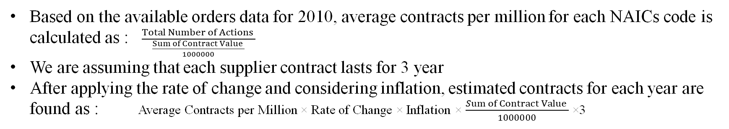
Historical orders analysis
Based on the available orders data for 2010, average contracts per million for each NAICs code is calculated as : $\frac{Total Number of Actions }{\frac{Sum of Contract Value }{1000000}}$
We are assuming that each supplier contract lasts for 3 year
After applying the rate of change and considering inflation, estimated contracts for each year are found as : Average Contracts per Million × Rate of Change × Inflation × $\frac{Sum of Contract Value }{1000000}$ ×3

Slide 36
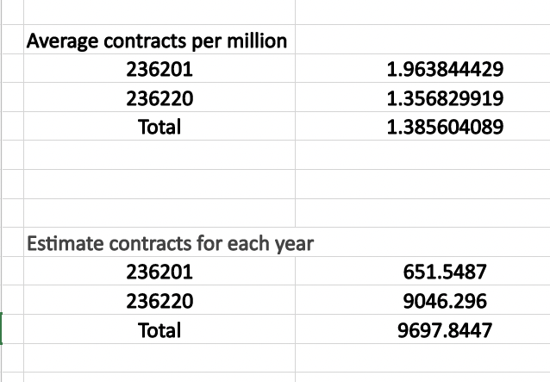
Proposed number of orders
Considering the change in inflation and rate of change, with an assumption of each contract lasting for 3 years, the number of orders is estimated.
A total number of approximately 48490 orders are estimated over the period of the next 5 years
236201 : 3260
236220 : 45230

Slide 37
Issues/Challenges
Standardized categorization of commodities could help resolve the inconsistency.
Cleaned and standardized supplier information could help resolve the issue of the same supplier having different DUNS numbers. A unique identifier is more useful.
The number of purchasing places is dispersed. Organizational structure and hierarchical information are required.
More contract information such as negotiation terms, expiration date, KPIs would help to know more granularity about the contract.
To enhance forecasting accuracy, more historical data is required(including market circumstances, and past economic, and external factors). Larger economic data could produce a reliable trend analysis.
More information is needed on competitive quotations for historical expenditure to conduct a competitive analysis.

Slide 38
Issues/Challenges
Strong data security mechanisms need to be implemented to protect data security and privacy issues.
Unreliable categorization and inconsistency in a commodity category.
Energy consumption data, sustainability procedures or environmental impact data add-on helps in the cost and impact analysis.
More supplier data on financial health such as historical financial health, credit statements, and FPI would help to sort the suppliers.
More compliance data including legal and regulatory changes affecting the suppliers, and compliance with regulatory requirements is required to know the risk.
The difficulty of mapping data with standardized classification arises due to inconsistencies in services categorization.

Slide 39
Collect & NormalizeData
Sort & Analyze Market Categories
Determine Market Category
Analyze Data Within Category and Select Market Basket
Start
Determine Desired Number of Contracts and Buying Locations for Market Basket
Develop and Evaluate Benefits and Drawbacks of Potential Sourcing Strategies
Perform Market Research on Market Basket
Perform Analysis of Historical Spending Within Market Basket
Select Final Sourcing Strategy
Determine Final Length of Contracts
Estimate Potential Cost Savings From Sourcing Strategy
End

Slide 40
references
O'Donnell, R., & Gray, D. (n.d.). The 5 Key Types of Construction Contracts. Procore. Retrieved December 9, 2023, from https://www.procore.com/library/construction-contract-types
Kenton, W., Brown, J. R., & Schmitt, K. R. (2023, February 17). Competition in Contracting Act (CICA): What It is, How It Works. Investopedia. Retrieved December 1, 2023, from https://www.investopedia.com/terms/c/competition-in-contracting-act.asp#:~:text=The%20CICA%20provides%20for%20full,days%20prior%20to%20bid%20solicitation.
(n.d.). Bidding on Federal Construction Projects. U.S. General Services Administration. Retrieved November 21, 2023, from https://www.gsa.gov/real-estate/real-estate-services/

Slide 41
references
(n.d.). Government Contracting Outlook Key Takeaways. RSM. Retrieved November 21, 2023, from https://rsmus.com/insights/industries/government-contracting/government-contracting-outlook.html
(n.d.). 2023 Commercial Construction Cost per Square Foot in the US. BigRentz. Retrieved November 22, 2023, from https://www.bigrentz.com/blog/commercial-construction-cost-per-square-foot
Hagan, S. (2023, January 27). 5 Government Contracting Trends to Follow in 2023. Winvale. Retrieved December 1, 2023, from https://info.winvale.com/blog/5-government-contracting-trends-follow-2023
(2023, February 17). Five Trends in Government Contracting for FY 2023. Bloomberg Government. Retrieved December 1, 2023, from https://about.bgov.com/brief/trends-in-federal-contract-spending/

Slide 42
references
Ellis, G. (2023, July 28). 8 Innovations that Will Change Construction As We Know It. Construction Blog. Retrieved December 1, 2023, from https://constructionblog.autodesk.com/construction-innovations/
(n.d.). 36.204 Disclosure of the magnitude of construction projects. Acquisition.gov. Retrieved December 1, 2023, from https://www.acquisition.gov/far/36.204
(n.d.). Part 216 - Types of Contracts. Procore. Retrieved December 8, 2023, from https://www.acquisition.gov/dfars/part-216-types-contracts
(n.d.). 2022 U.S. Construction Cost Trends. CBRE. Retrieved December 1, 2023, from https://www.cbre.com/insights/books/2022-us-construction-cost-trends/01-introduction

